Slide 1


UIDAI PROJECT: USE OF TECHNOLOGY IN INCREASING EFFICIENCY,DELIVERY AND TRANSPARENCY
Mera Aadhaar, Meri Pehchaan

Slide 2


Presentation By: Mohd. Aquib Ansari (2015ucp1686) Sahas Reddy (2015ucp1714)

Slide 3
CONTENT
Why do we need Identity?
Formation of UIDAI
UIDAI project
Composition of UIDAI authority
More about UIDAI project
Identification before UIDAI project
Generation of UID number
Pictorial representation for process of Aadhaar generation
UID
Enrolment in UIDAI project
Expenditure on UIDAI project
Features of Aadhaar

Slide 4
Challenges in generating UID
Challenges with previous subsidy and welfare payments framework
Desired elements of a subsidy framework
Role of Aadhaar in fulfilling the desired elements of subsidy framework
How Aadhaar helps
Technological advancement
Aadhaar enabled payment system
Government’s saving with Aadhaar
Difficulties with Aadhaar usage
Conclusion

Slide 5
Why do we need UID?
For people to prove their identity to avail basic rights and benefits.
Government account for money and resource flow in economy.
Aadhaar is Indian version of American social security card or Canada’s social security number.

Slide 6

Formation of UIDAI
Empowered Group of Ministers(EGoM) was formed on 4 December 2006.
Fourth meeting of EGoM’s was held on 4 November 2008, The Unique Identification Authority of India was formed as an attached office under the Planning Commission with an initial core team of 115 officials.
UIDAI functioned as an attached office of Planning Commission(Now NITI Aayog) since 28 January 2009.
Shri Nandan Nilekani, co-founder of Infosys was appointed as the Chairman of UIDAI on 23 July 2009, he assumed the charge and since then UIDAI Project has started functioning.

Slide 7
UIDAI project
The Unique Identification Authority of India(UIDAI) is a statutory authority established under the provisions of Aadhaar Act 2016 on 12 July 2016 by the Government of India, under the Ministry of Electronics and Information Technology.
UIDAI project has the vision of empowering every resident of India with a unique identity and providing a digital platform to authenticate anytime anywhere.

Slide 8
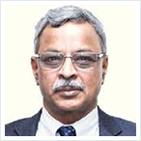
Composition of UIDAI authority
Shri J Satyanarayna, Chairman(part-time),UIDAI
Shri J Satyanarayna, IAS retd. (1977, AP cadre) is the
part-time Chairman of Unique Identification Authority
of India.
Dr. Ajay Bhushan Pandey, Chief Executive Officer(CEO),UIDAI
Shri Rajesh Jain, Member(part-time),UIDAI
Dr. Anand Deshpande, Member(part-time),UIDAI

Slide 9
More about UIDAI project
On 3 March 2016, a money bill was introduced in the Parliament to give legislative backing to Aadhaar .Then, on 11 March 2016 Aadhaar act was passed in Lok Sabha.
The Union Government has notified the Aadhaar (Targeted delivery of Financial and other subsidies,benefits and services)Act,2016.This Act will provide statutory backing for transfer of subsidies and benefits to eligible people having Aadhaar(UID) number.

Slide 10
More about UIDAI project (continued)
The UIDAI project has evolved into a vital digital infrastructure . Meticulous planning and execution enabled the project to reach the scale that never achieved in any biometric identity system in the world.
The main strategy of UIDAI’s working centres around a CIDR( Central ID Data Repository) which will work at central level. On the peripheries it will be co-ordinated by Registrars who will resident touch through enrolment agencies.
The technology centre was the first unit of UIDAI to start functioning in 2009 in Bangalore.
The UIDAI’s data centre is located at Industrial Model Township(IMT), Manesar.

Slide 11
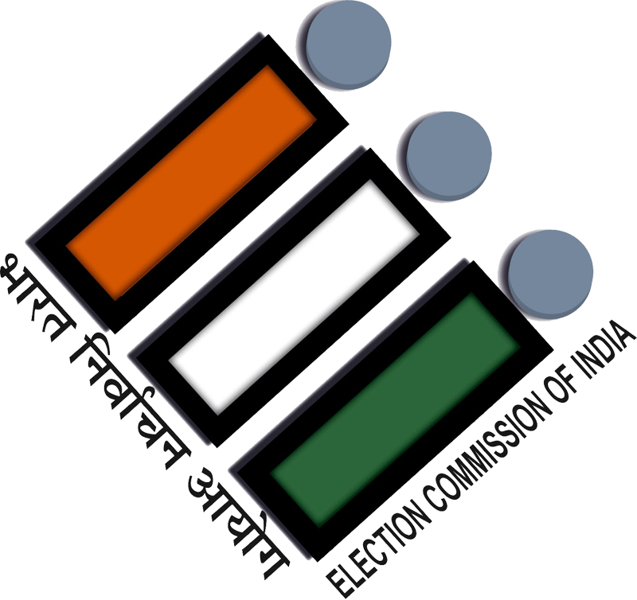
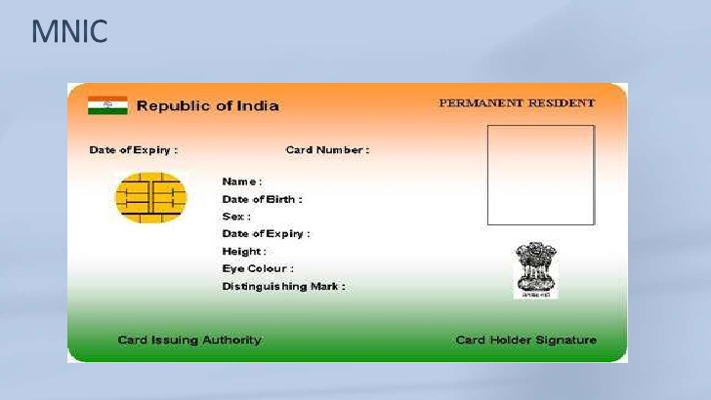
Identification before UIDAI project
Firstly, the Government of India took an effort to provide a clear identity to its residents in 1993, with the issue of photo identity cards by Election Commission.
In 2003, Indian Government approved the Multipurpose National Identity Card(MNIC).

Slide 12
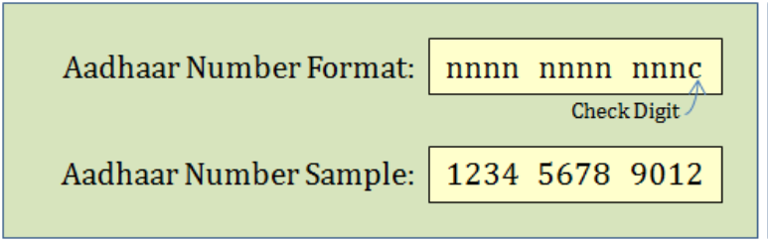
Generation of UID number
The UIDAI is mandated to assign a 12-digit unique identification number(UID) termed as Aadhaar to all the residents of India.
The UID number will not contain intelligence . In older systems it was customary to load.

Slide 13
Generation of UID number(Continued)
The UID number will be a random number.
Required information for generation of UID:
Aadhaar enrolment only seeks the following demographic and
biometric information.
Name
Date of birth(or Age)
Gender
Address
Mobile number and Email(optional)
Ten fingerprints , two iris scans and facial photograph(Biometric)
For children under five years old , name of the guardian is mandatory
(Father/Mother/Guardian)

Slide 14
Pictorial representation for process of Aadhaar generation

Slide 15
Once the UID number is assigned , the UIDAI will forward the resident a letter containing his/her registered demographic and biometric details and a tearaway portion , which has the UID number , photograph and demographic information and a 2D bar code of the fingerprint.
UID number

Slide 16
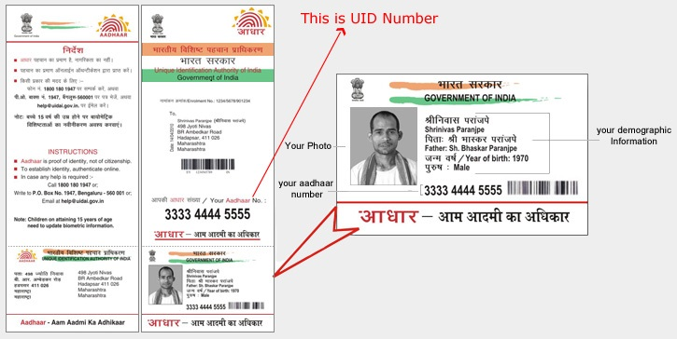
UID (Continued)

Slide 17
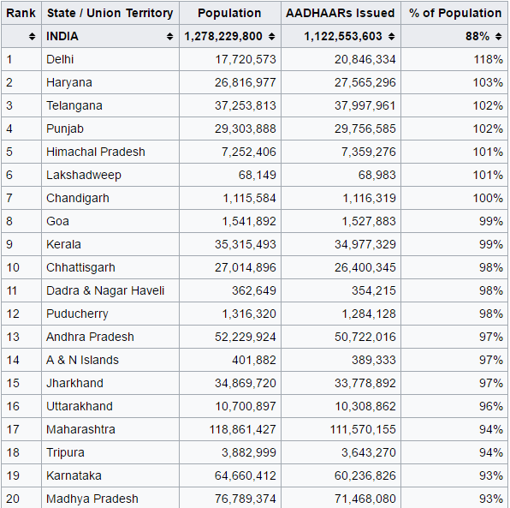
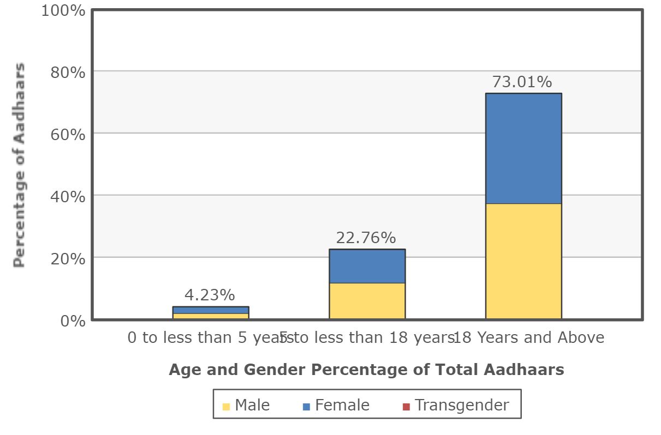
Enrolment in UIDAI project
Source : "Public Data Portal". UIDAI. Retrieved 12 March 2017

Slide 18
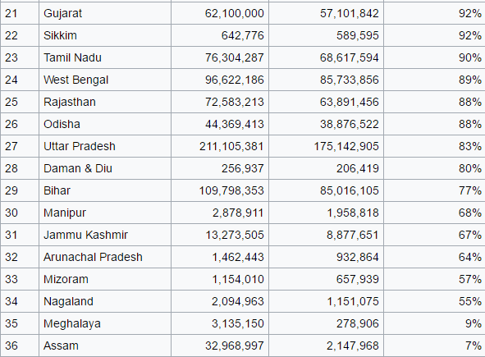
Enrolment in UIDAI project(Continued)
Source: "Public Data Portal". UIDAI. Retrieved 12 March 2017.

Slide 19
Enrolment in UIDAI project(Continued)
As of 12 March 2017 , 1.127 billion Aadhaar number had been issued.
Over 99% of the 18+ age population was covered as of this date.

Slide 20
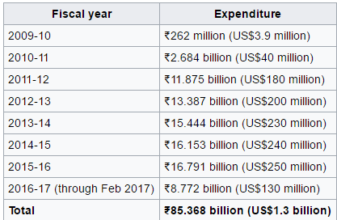
Expenditure on UIDAI project
From the beginning of the project in 2009 through February 2017, the Government spent a total of ₹85.368 billion (US$1.3 billion) on the UIDAI project.
Source : "UIDAI Finance and Budge Section". UIDAI. Retrieved 12 March 2017.

Slide 21
Features of Aadhaar
UIDAI only provides identity .
Aadhaar number proves identity but not citizenship.
Enrolment of residents with proper verification.
At initial stage, Government used to deliver a sheet of paper with a government logo and UID number printed on it ,later government started delivery in the form of polyvinyl card.
Aadhaar number doesn’t contain any intelligence.
Online authentication.

Slide 22
Challenges in generating UID
Technical Risks:
Unstable biometrics.
Inability to handle huge number of transactions per
second.
Errors in data recording and data compilation.
External Risk:
Sharing of personal data with a non-trustworthy party.
Political risk.
Organizational Risk:
Duplicate and fake identities (human behaviour risk).
Training risk.
Project management risk.

Slide 23
Challenges with the previous subsidy and welfare payments framework
The fundamental challenge for any subsidy framework
is to ensure effective targeting of beneficiaries.
Accurate beneficiary identification has traditionally
been a complex task for social security and welfare
programs.
Targeting errors within social and welfare programs are
of two types :
a. Errors of inclusion.
b. Errors of exclusion.

Slide 24
The former involves the wrongful inclusion of beneficiaries ineligible for the subsidy, while the latter concerns the exclusion of eligible beneficiaries.
Addressing wrongful inclusion is one of the most
formidable administrative challenges for Governments.
This includes the problem of ghost beneficiaries and
fakes. Different eligibility norms come with different
challenges.
For example, it is extremely difficult to accurately assess
income, one of the most common form of eligibility
criteria, with any reasonable degree of accuracy.

Slide 25
The lack of electronic databases of beneficiaries and the lack of a common unique identifier leads to misreporting of information to receive benefits.
A common example is that of the same beneficiary
receiving subsidy for both fuels, kerosene and LPG.
The second targeting error, the exclusion of eligible
beneficiaries, is one of the biggest problems with many
prevailing subsidy schemes.
Also, socially disadvantaged communities are left out of
social subsidy programs, often due to discrimination.

Slide 26
Many beneficiaries get excluded because they are unaware of the scheme or are unable to fulfil the procedural formalities or provide the documentation required or due to rent seeking middlemen.
Since subsidies, by definition, provide the delivery of
goods or services at prices that are lower than market
prices, they generate several incentive distortions among
those delivering, administering and receiving it.
The nature of these distortions depends on the type of
good, its alternative usages, market micro-structure, and
the subsidy delivery mechanism.

Slide 27
Any effective subsidy framework has to incorporate the following elements: i. Empowerment and choice for beneficiaries. ii. Transparency in subsidy administration and information visibility . iii. One price for subsidized goods . iv. Efficiency in production . v. Support all types of direct subsidy transfer models. vi. Fully electronic service delivery .
Desired elements of a subsidy framework

Slide 28
Use of technology: in increasing efficiency,delivery and transparency

Slide 29
Role of Aadhaar in fulfilling the desired elements of subsidy framework
Ensures one beneficiary has one number across subsidy programs.[EFFICIENCY]
Enables real-time authentication of identity at the time of subsidy delivery.[TRANSPARENCY]
Enables delivery of welfare benefits and subsidies through direct transfers into Aadhaar enabled Bank Accounts (AEBA) using the Aadhaar Payments Bridge.[DELIVERY]
Fully electronic service delivery.

Slide 30
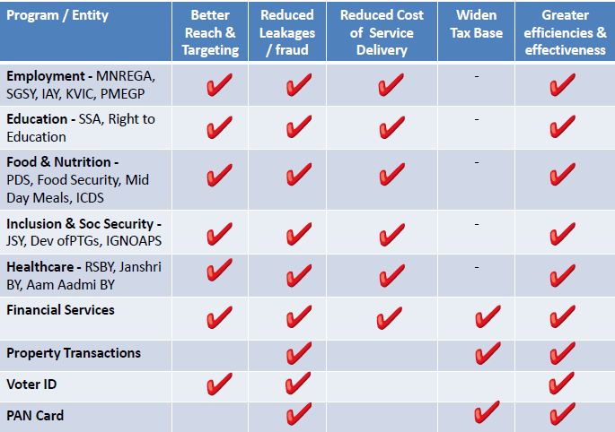
How Aadhaar helps

Slide 31



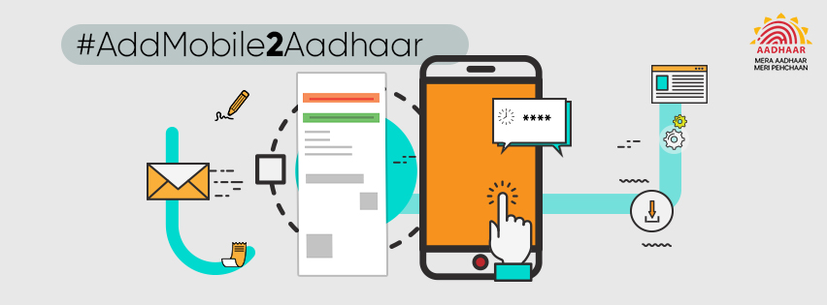
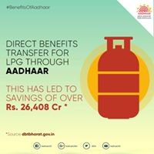

Technological advancement

Slide 32

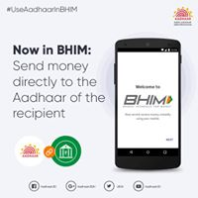
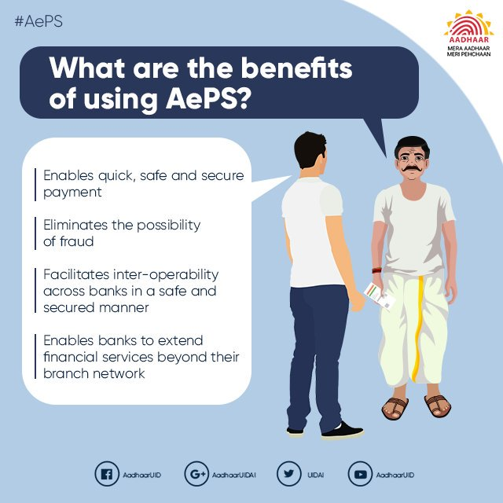
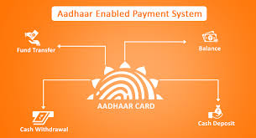
Aadhaar enabled payment system

Slide 33
The new payment service offered by the National
Payments Corporation of India to banks, financial
institutions using ‘Aadhaar’, the Unique Identification
Authority of India (UIDAI) issued unique identification
number shall be known as ‘Aadhaar Enabled Payment
System’ and shall be referred to as “AEPS” hereinafter.
AEPS Aadhaar is used as the identity of customer to
access the respective Aadhaar enabled bank account and
perform basic banking transactions like balance enquiry,
Cash deposit, cash withdrawal, remittances that are
intra bank or inter bank in nature, through a Business
Correspondent.

Slide 34
Government’s saving with Aadhaar
India’s Aadhaar ID is saving approximately $1 billion
(Rs. 650 crores) a year by reducing corruption and
leakage for the Indian government said by The World
Bank.
It helps in fiscal budgeting . It help in other useful services as said by World Bank’s Chief Economist Kaushik Basu.

Slide 35
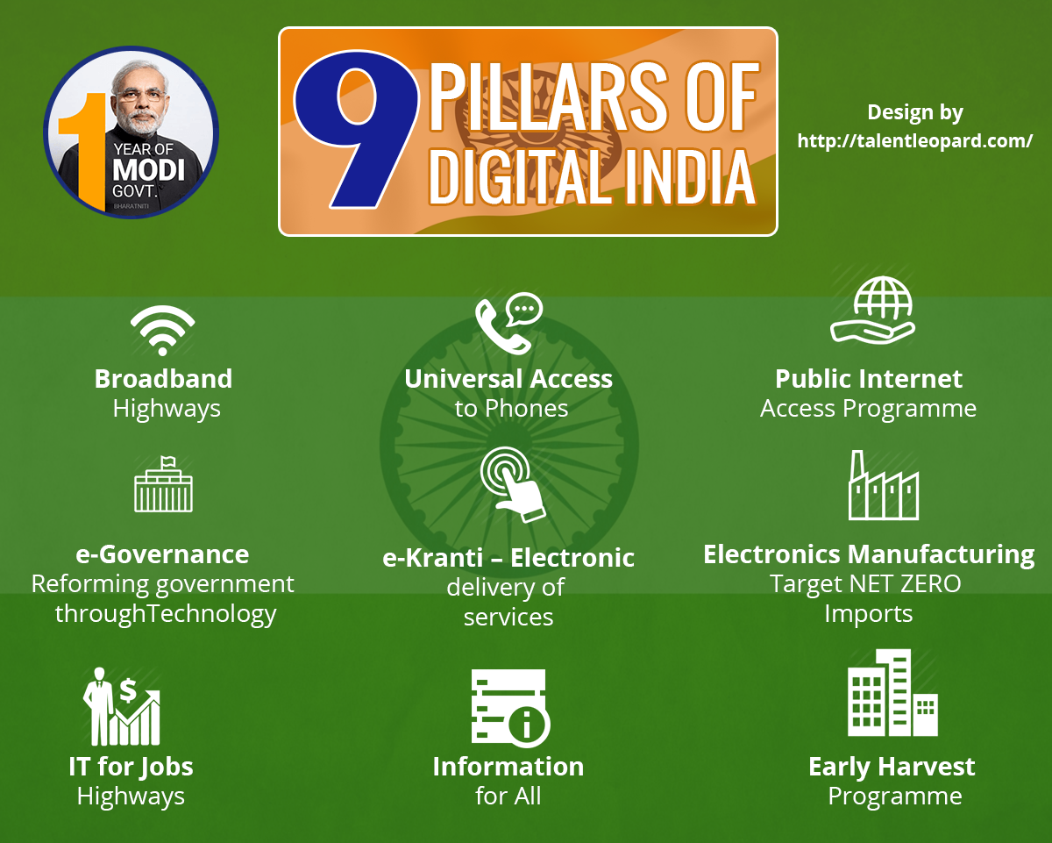

Aadhaar plays crucial role in digitalization by it’s
services like:
AEPS
EKYC
BHIM APP
Linking Aadhaar with ration , LPG and other services.

Slide 36
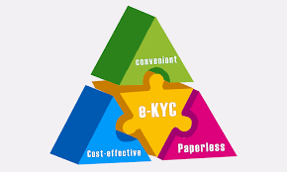

EKYC: UIDAI offers the ekyc service, which enables a resident having an aadhaar number to share their demographic information and photograph with a UIDAI partner organization in an online, secure, auditable manner with the residents consent. The consent by the resident can be given via a biometric authentication or an one time password (OTP) authentication.

Slide 37
Difficulties with Aadhaar usage
People who are still un enrolled for aadhaar are facing
many difficulties such as :
i. Unable to access almost all government benefits.
ii. Aadhaar is necessary for attempting most of board
exams .
Some functional errors which delivered card with
incorrect information.
Most of the rural area people are unaware of
advanced technology involved in accessing services
like Ekyc , Apes, Linking of bank account with aadhaar
etc.
Unauthorized use.
Privacy and security concern.

Slide 38
Conclusion
It is the world’s largest ID platform. It is also the largest
biometric programme in the world making India a global
leader in biometric technology.
Can be used to monitor development related parameters
in such critical sectors as healthcare, education, etc. This
can also facilitate development of electronic applications
to bridge any gaps observed.
Can help to map skilled manpower, based on the
vocational training acquired by the individual, to suitable
job vacancies/ skill requirements of the State.

Slide 39
Conclusion
Enables instant paperless bank account opening, instant
issuance of insurance and acts as a permanent financial
address.
It is simple to use: it is not necessary for state to have a
high degree of IT capability to adopt and initiate Aadhaar
related service .
Helps in significantly reducing costs by increasing
administrative efficiency and reducing leakages.

Slide 40
Provides a single view of beneficiary data and
information.
Unique identification number of a beneficiary across all social welfare programmes helps in increasing efficiency, transparency and delivery.

Slide 41


